Slide 1
Displaying Distributions: Quantitative Variables
When a variable is quantitative, there are no natural categories.
Example: Consider the data
giving the particulate emissions for 65 vehicles in grams per gallon.
The maximum value is 6.64, while the minimum value is 0.25.
How are the values distributed?
1.5 | 0.87 | 1.12 | 1.25 | 3.46 | 1.11 | 1.12 | 0.88 | 1.29 | 0.94 | 0.64 | 1.31 | 2.49
1.48 | 1.06 | 1.11 | 2.15 | 0.86 | 1.81 | 1.47 | 1.24 | 1.63 | 2.14 | 6.64 | 4.04 | 2.48
1.4 | 1.37 | 1.81 | 1.14 | 1.63 | 3.67 | 0.55 | 2.67 | 2.63 | 3.03 | 1.23 | 1.04 | 1.63
3.12 | 2.37 | 2.12 | 2.68 | 1.17 | 3.34 | 3.79 | 1.28 | 2.1 | 6.55 | 1.18 | 3.06 | 0.48
0.25 | 0.53 | 3.36 | 3.47 | 2.74 | 1.88 | 5.94 | 4.24 | 3.52 | 3.59 | 3.1 | 3.33 | 4.5

Slide 2
Graphical Methods: Quantitative Variables
Graphical Methods often convey important information about the structure of the data set including:
Overall shape of the data set (e.g., symmetric or skewed)
Presence of gaps in the data set
Number and location of peaks (modes) in the data set
Presence of outliers
Identification of a representative value and the extent of spread
Some single variable graphical methods include:
Stem-and-Leaf Displays
Dotplots
Histograms

Slide 3
Example of Stem-and-Leaf Plot
Raw Data (Test Grades): 67, 72, 85, 75, 89, 89, 88, 99, 90, 100, 120
Stem
Leaves
Stem
Leaves
6
7
8
9
10
11
12
7
2 5
5 9 9 8
9 0
0
0
6
7
8
9
10
11
12
7
2 5
5 8 9 9
0 9
0
0
Unordered Leaves
Ordered Leaves
6 | 7 represents 67

Slide 4
Stem-and-Leaf Plot
It is sometimes helpful to round the data to a convenient number of figures before constructing the plot.
Example: Recall the particulate emissions data
1.5 | 0.87 | 1.12 | 1.25 | 3.46 | 1.11 | 1.12 | 0.88 | 1.29 | 0.94 | 0.64 | 1.31 | 2.49
1.48 | 1.06 | 1.11 | 2.15 | 0.86 | 1.81 | 1.47 | 1.24 | 1.63 | 2.14 | 6.64 | 4.04 | 2.48
1.4 | 1.37 | 1.81 | 1.14 | 1.63 | 3.67 | 0.55 | 2.67 | 2.63 | 3.03 | 1.23 | 1.04 | 1.63
3.12 | 2.37 | 2.12 | 2.68 | 1.17 | 3.34 | 3.79 | 1.28 | 2.1 | 6.55 | 1.18 | 3.06 | 0.48
0.25 | 0.53 | 3.36 | 3.47 | 2.74 | 1.88 | 5.94 | 4.24 | 3.52 | 3.59 | 3.1 | 3.33 | 4.5
This data is rounded to tenths
1.5 | 0.9 | 1.1 | 1.3 | 3.5 | 1.1 | 1.1 | 0.9 | 1.3 | 0.9 | 0.6 | 1.3 | 2.5
1.5 | 1.1 | 1.1 | 2.2 | 0.9 | 1.8 | 1.5 | 1.2 | 1.6 | 2.1 | 6.6 | 4 | 2.5
1.4 | 1.4 | 1.8 | 1.1 | 1.6 | 3.7 | 0.6 | 2.7 | 2.6 | 3 | 1.2 | 1 | 1.6
3.1 | 2.4 | 2.1 | 2.7 | 1.2 | 3.3 | 3.8 | 1.3 | 2.1 | 6.6 | 1.2 | 3.1 | 0.5
0.3 | 0.5 | 3.4 | 3.5 | 2.7 | 1.9 | 5.9 | 4.2 | 3.5 | 3.6 | 3.1 | 3.3 | 4.5
Producing the Stem-and-Leaf plot in R
> stem(Particulate)
The decimal point is at the |
0 | 355669999
1 | 01111112222333344555666889
2 | 11124556777
3 | 0111334555678
4 | 025
5 | 9
6 | 66
Key: 4|5 equals 4.5 g/gal

Slide 5
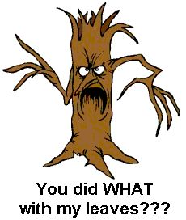
Stem-and-Leaf Plot

Slide 6
Dot Plots
Dot Plots are another simple way of displaying a single quantitative variable.
To construct the dot plot:
Draw an axis and mark off units along this axis that span the range of the data.
Place a dot (symbol) above the axis for each value in the data set.
If there are replicate values, they can be “stacked” above existing points. Alternatively, they can be “jittered” which adds some noise to their vertical position.
Also called a one-dimensional scatter plot.
Most useful for small and medium sized data sets.

Slide 7
Dot Plots from the Cars93 Data Frame
A pair of Dot Plots from the Cars93 data frame using the stack method:
> stripchart(Cars93$MPG.city,method="stack",pch=16,
+ cex.axis=1.2,cex.lab=1.2,xlab=“Miles per Gallon")
> stripchart(Cars93$Length,method="stack",pch=16,
+ cex.axis=1.2,cex.lab=1.2,xlab="Length (inches)")

Slide 8
Dot Plots from the Cars93 Data Frame
A pair of Dot Plots from the Cars93 data frame using the jitter method:
> stripchart(Cars93$MPG.city,method="jitter",pch=16,
+ cex.axis=1.2,cex.lab=1.2,xlab="Miles Per Gallon (city)")
> stripchart(Cars93$Length,method="jitter",pch=16,
+ cex.axis=1.2,cex.lab=1.2,xlab="Length (inches)")

Slide 9

Displaying Distributions: Histogram

Slide 10
Displaying Distributions: Histogram
When a variable is quantitative, there are no natural categories. One strategy is to divide the range of the data into classes that cover all the values that are observed.
Example: Recall the data
giving the particulate emissions for 65 vehicles in grams per gallon.
The maximum value is 6.64, while the minimum value is 0.25.
How are the values distributed?
1.5 | 0.87 | 1.12 | 1.25 | 3.46 | 1.11 | 1.12 | 0.88 | 1.29 | 0.94 | 0.64 | 1.31 | 2.49
1.48 | 1.06 | 1.11 | 2.15 | 0.86 | 1.81 | 1.47 | 1.24 | 1.63 | 2.14 | 6.64 | 4.04 | 2.48
1.4 | 1.37 | 1.81 | 1.14 | 1.63 | 3.67 | 0.55 | 2.67 | 2.63 | 3.03 | 1.23 | 1.04 | 1.63
3.12 | 2.37 | 2.12 | 2.68 | 1.17 | 3.34 | 3.79 | 1.28 | 2.1 | 6.55 | 1.18 | 3.06 | 0.48
0.25 | 0.53 | 3.36 | 3.47 | 2.74 | 1.88 | 5.94 | 4.24 | 3.52 | 3.59 | 3.1 | 3.33 | 4.5

Slide 11
Choosing the Classes
Requirements for Choosing Classes
Every observation must fall into one of the classes
The classes must not overlap
Classes of equal width
There must be no gaps between classes, even if there are no observations in a class, it is included in the frequency distribution
Relative Frequency Distribution of Particulate Data
Class | Frequency | Relative Frequency
0.00-0.99 [0, 1) | 9 | 0.138
1.00-1.99 [1, 2) | 26 | 0.400
2.00-2.99 [2, 3) | 11 | 0.169
3.00-3.99 [3, 4) | 13 | 0.200
4.00-4.99 [4, 5) | 3 | 0.046
5.00-5.99 [5, 6) | 1 | 0.015
6.00-6.99 [6, 7) | 2 | 0.031

Slide 12
Histogram of Age
The following is a histogram of the 20 ages of the attendees of an academic conference.
45, 41, 51, 46, 47, 42, 43, 50, 39, 32, 41, 44, 47, 49, 45, 42, 41, 40, 45, 37
Class | Tally | # Observations | Proportion/Percentage
[30, 35) | / | 1 | 1/20 = 0.05 → 5%
[35, 40) | // | 2 | 2/20 = 0.10 → 10%
[40, 45) | //////// | 8 | 8/20 = 0.40 → 40%
[45, 50) | /////// | 7 | 7/20 = 0.35 → 35%
[50, 55) | // | 2 | 2/20 = 0.10 → 10%
Frequency
Relative Frequency
Age
Age
Both the Frequency and Relative Frequency histogram reveal the same shape of the distribution.

Slide 13


Slide 14
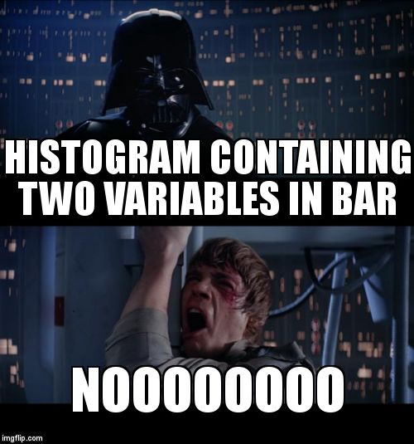

Slide 15

Selecting the Number of Classes?
A good rule of thumb is number of classes ≈

Slide 16
Histogram of Particulate Data
Class | Frequency | Relative Frequency
0.00-0.99 [0, 1) | 9 | 0.138
1.00-1.99 [1, 2) | 26 | 0.400
2.00-2.99 [2, 3) | 11 | 0.169
3.00-3.99 [3, 4) | 13 | 0.200
4.00-4.99 [4, 5) | 3 | 0.046
5.00-5.99 [5, 6) | 1 | 0.015
6.00-6.99 [6, 7) | 2 | 0.031
> hist(Particulate,cex.lab=1.2,cex.axis=1.2,col="lightgray",
+ xlab="Particulate (g/gal)")

Slide 17
Histogram of Particulate Data
Setting the classes using breaks
> hist(Particulate,cex.lab=1.2,cex.axis=1.2,col="lightgray",breaks=seq(0,7,.5),
+ xlab="Particulate (g/gal)")
> box()
Above, the command seq(0,7,.5)creates the vector with the sequence
(0, 0.5, 1, 1.5, 2, 2.5, 3, 3.5, 4, 4.5, 5, 5.5, 6, 6.5, 7)
which is used for the endpoints of the histogram classes.

Slide 18
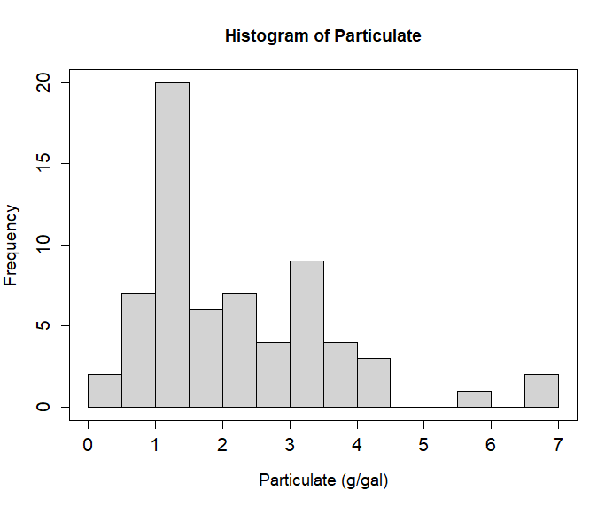
Histogram of Particulate Data
Setting the classes using breaks
> hist(Particulate,breaks=14,col="lightgray",xlab="Particulate (g/gal)",
+ cex.lab=1.2,cex.axis=1.3)
> box()
Above, the command setting breaks to 14 tells R we would like 14 classes.
Note: when an integer is used in the breaks argument, the number is taken as a suggestion only, and the breakpoints will be set to “pretty” values.

Slide 19
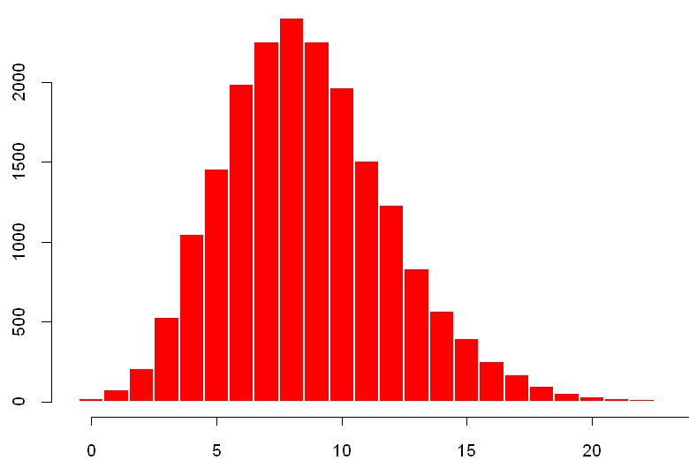

Histograms for Discrete Data
When the data are discrete, we can construct a frequency distribution in which each possible value of the variable forms a class.
Each rectangle represents one value of the variable
Rectangles are just wide enough to touch
This tells you on the spot that what you have is in fact a barplot!!
You can create such graphs as barplots in R.
Example: Below are the frequency and relative frequency histograms for the number of hits in a 9-inning game for 19,383 baseball games.
Frequency
Relative Frequency
Hits
Hits

Slide 20
Shapes of Distributions
A histogram is symmetric if its right half is a mirror image of its left half.
− Rarely perfectly symmetric, many are
approximately symmetric
A histogram is skewed to the right if it has a long right-hand tail.
− Also called positively skewed.
A histogram is skewed to the left if it has a long left-hand tail.
− Also called negatively skewed.

Slide 21
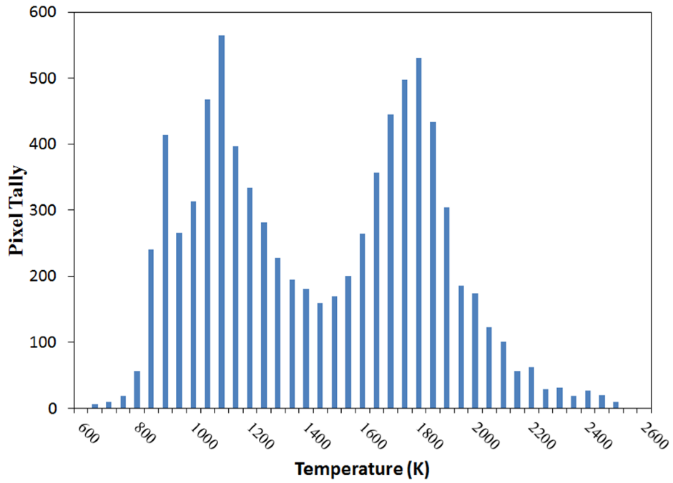
Modes
A peak, or high point, of a histogram is referred to as a mode.
− A histogram is unimodal if it has only one mode and
bimodal if it has two distinct modes.
− A histogram can have three or more modes, but this is
rarely seen in practice
− Modes often represent different populations within the group
Elvidge CD, Zhizhin M, Baugh K, Hsu F-C, Ghosh T. Methods for Global Survey of Natural Gas Flaring from Visible Infrared Imaging Radiometer Suite Data. Energies. 2016; 9(1):14.

Slide 22
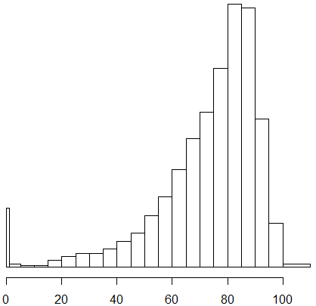
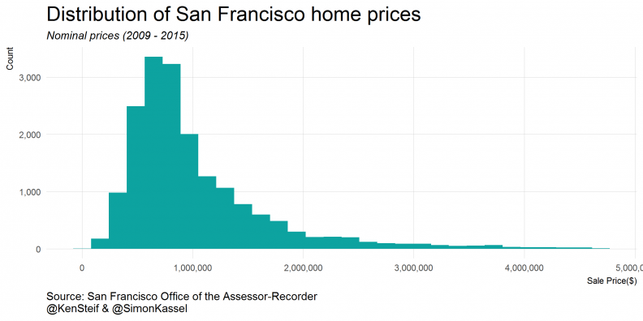
Shapes of Distributions
What shape would you expect for the following distributions?
Age at death of American citizens
Home prices in a metropolitan area?

Slide 23
How about numerical summaries? Measures of Center
Definition: Measures of center are numerical values that attempt to report in some sense the “middle” of a set of data.
Notation:
Σ denotes the addition (or sum) of a set of values
x is the variable used to represent individual data values
n represents the number of data values in a sample
N represents the number of data values in a population
A list of n numbers is denoted x₁, x₂, …, x_{n}
The sum of these numbers is Σx_{i} = x₁ + x₂ + … + x_{n}

Slide 24
Measures of Center
Suppose we want to add up n numbers
We write this compactly as
upper limit of the summation
means sum
terms
lower limit of the summation
index of summation
Find
Find

Slide 25
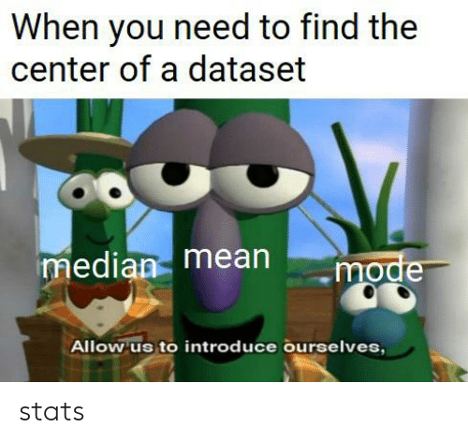

Slide 26
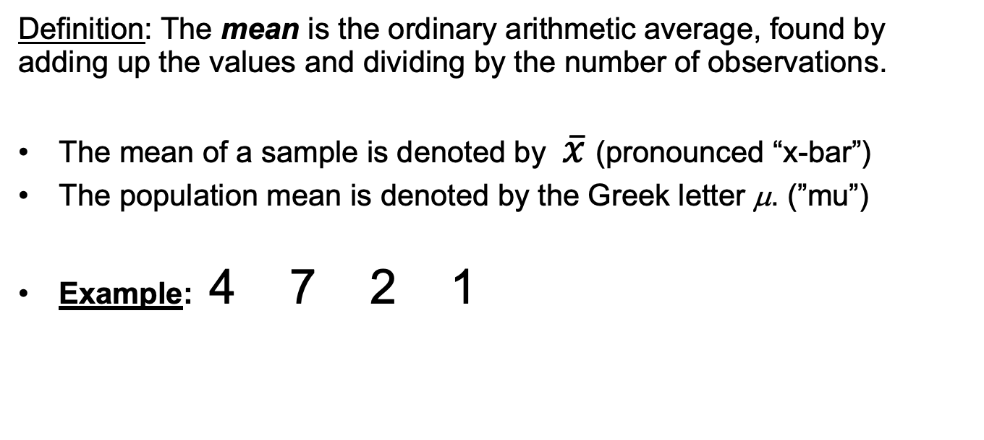
The Mean
Definition: The mean is the ordinary arithmetic average, found by adding up the values and dividing by the number of observations.
The mean of a sample is denoted by $\overline{x}$(pronounced “x-bar”)
The population mean is denoted by the Greek letter μ. (”mu”)
Example: 4 7 2 1
1
3
5
7

Slide 27
Is the Mean Always the Center?
Can you think of a situation where the mean is not as “informative”?

Slide 28
Is the Mean Always the Center?
1
2
3
4
1
2
3
8
Mean = 2.5
Mean = 3.17
1
2
3
25
Mean = 6
The mean shifts towards an extreme observation.
If a distribution appears skewed, we may wish to also report a more resistant measure of center.
Note: The mean is not necessarily a “typical” value for the data set.

Slide 29
The Median
Definition: The median is the “middle” observation (once the values are arranged in order)
To calculate the median M, sort all observations from smallest to largest:
If n is odd, M is the middle number in the list
If n is even, M is the mean of the middle two numbers in the list
The symbol is also commonly used for the median.
The median is the 50th percentile.

Slide 30
Median Example
Odd number: 6.72 3.46 3.60 6.44 26.70
First arrange the values in order, then pick the middle value
3.46 3.60 6.44 6.72 26.70
Even number: 6.72 3.46 3.60 6.44
First arrange the values in order, then compute the mean of the two middle values
3.46 3.60 6.44 6.72
M

Slide 31
Median is Resistant
Definition: A statistic is resistant if its value is not affected much by extreme values (in either direction) in the data set.
Recall the median of the following data set:
3.46 3.60 6.44 6.72 26.70
Suppose the last number was incorrectly recorded as 2670. Would the median change?
The median would stay the same.
M
The median is resistant, but the mean is not.

Slide 32
The Mode
Definition: The mode of a data set is the value that occurs most frequently.
When two or more values occur with the same frequency, each one is a mode.
If no value appears more than once, we say the data set has no mode
Examples:
{ 0, 0, 0, 0, 1, 1, 2, 2, 3, 4 }
{ 0, 0, 0, 1, 1, 2, 2, 2, 3, 4 }

Slide 33
Mode Continued
The mode can be computed for qualitative data.
Example: Suppose that eye color was categorized as follows:
Brown, Blue, or Green
0.60
Relative Frequency
0.20
Brown
Blue
Green

Slide 34
Relationships of Measures of Center
Mode = Mean = Median
Symmetric & Unimodal
Mean
Mode
Mode
Mean
Median
Median
Left Skewed
Right Skewed

Slide 35
Examples from the Cars93 Data Frame
Manufacturer Model Type Min.Price Price Max.Price MPG.city MPG.highway AirBags
1 Acura Integra Small 12.9 15.9 18.8 25 31 None
2 Acura Legend Midsize 29.2 33.9 38.7 18 25 Driver & Passenger
3 Audi 90 Compact 25.9 29.1 32.3 20 26 Driver only
4 Audi 100 Midsize 30.8 37.7 44.6 19 26 Driver & Passenger
5 BMW 535i Midsize 23.7 30.0 36.2 22 30 Driver only
6 Buick Century Midsize 14.2 15.7 17.3 22 31 Driver only
Get the mean and median of MPG.city
> mean()
> median()
Mode of # of cylinders? # of airbags?
> table()

Slide 36
What if you want to visualize more than one variable, aka relationships?
Given paired data, we may wish to determine if there is a relationship between the two variables and, if so, identify what the relationship is.
Does blood pressure predict life expectancy?
Do SAT scores predict college performance?
If such a relationship exists, perhaps we can find an equation describing it, then we could use the equation to make predictions, aka regression. (more on this later in the course!)

Slide 37
Visualizing Bivariate Data with a Scatterplot
Size (Sq. ft.) | 2521 | 2555 | 2735 | 2846 | 3028 | 3049 | 3198 | 3198
Selling Price ($1000s) | 400 | 426 | 428 | 435 | 469 | 475 | 488 | 455
The table gives the size in square feet and the selling price in 1000s of dollars, for a sample of houses in a suburban Denver neighborhood. Here, each house is a unit and contributes an ordered pair of numbers: (Size, Selling Price) NOTE: Correlation does not mean causation!!

Slide 38
Examples from the Cars93 Data Frame
> plot(MPG.highway~Horsepower,data=Cars93,pch=16,cex.lab=1.2,cex.axis=1.2)
> plot(MPG.highway~MPG.city,data=Cars93,pch=16,cex.lab=1.2,cex.axis=1.2)

Slide 39
Examples from the Cars93 Data Frame
Or,
> plot(Cars93$Horsepower, Cars93$MPG.highway,pch=16,cex.lab=1.2,cex.axis=1.2)
> plot(Cars93$MPG.city, Cars93$MPG.highway,pch=16,cex.lab=1.2,cex.axis=1.2)

Slide 40
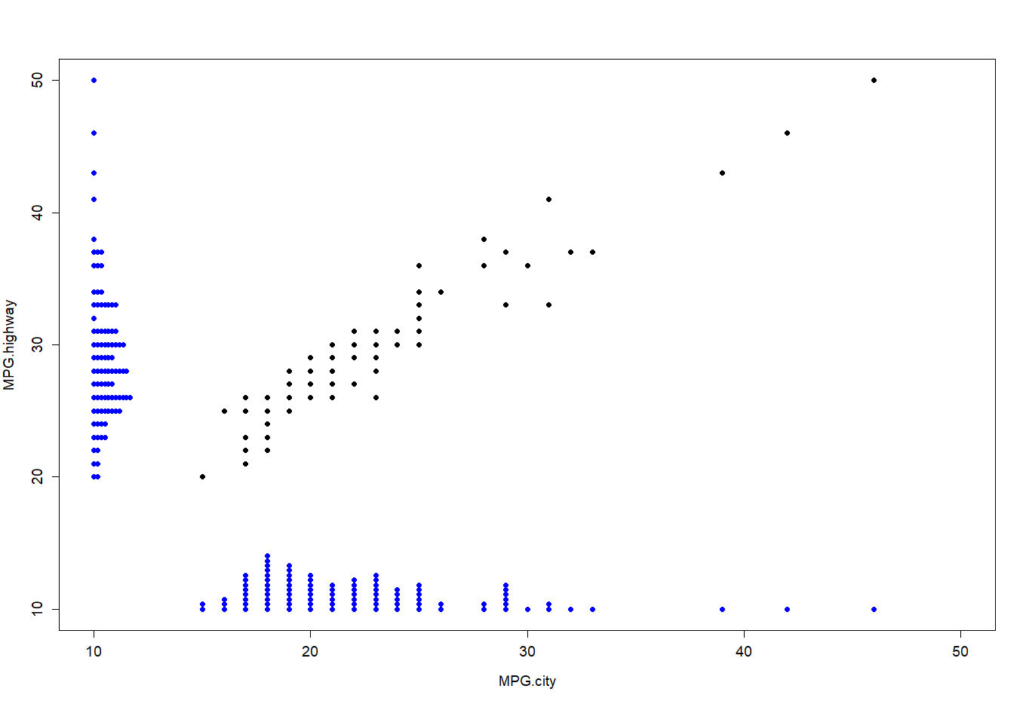
Adding a dotplot to a Scatterplot
You can also add a dotplot to a scatterplot using the stripchart function with the add=T argument as follows:
> plot(MPG.highway~MPG.city,data=Cars93,pch=16,cex.lab=1.2,cex.axis=1.2,
+ ylim=c(10,50),xlim=c(10,50))
> stripchart(Cars93$MPG.city,add=T,method="stack",at=10,col="blue",pch=16)
> stripchart(Cars93$MPG.highway,add=T,vertical=T,method="stack",at=10,col="blue",pch=16)

Slide 41
Layout option
We can use the layout command to place boxplots or histograms in the margins of a scatterplot to provide the distribution of the variables in the axes.
Usage
layout(mat, widths = rep.int(1, ncol(mat)), heights = rep.int(1, nrow(mat)), respect = FALSE)
Numbers on the right follow the order which you run your graph lines:
> matrix(c(1,2,3,4),nrow=2,byrow=T)
[,1] [,2]
[1,] 1 2
[2,] 3 4
1
2
3
4

Slide 42
Using the layout Function
You can control the widths of the columns and the heights of the rows using the widths and heights optional arguments. (note: 0 gives no plot)
The function layout.show(n)plots (part of) the current layout, namely the outlines of the next n figures.
> layout(matrix(c(2,0,1,3),nrow=2,byrow=T),widths=c(2,1),heights=c(1,2))
> layout.show(n=3)
> layout(matrix(c(2,2,0,1,1,3,1,1,3),nrow=3,byrow=T))
> layout.show(n=3)
widths
2
2
heights
1
3
1
3

Slide 43
Including Boxplots with a Scatterplot
> layout(matrix(c(2,0,1,3),nrow=2,byrow=T),widths=c(2,1),heights=c(1,2))
> plot(MPG.highway~MPG.city,data=Cars93,pch=16,cex.lab=1.2,cex.axis=1.2)
> boxplot(Cars93$MPG.city,horizontal=T,cex.axis=1.2)
> boxplot(Cars93$MPG.highway,cex.axis=1.2)

Slide 44
Including Boxplots with a Scatterplot
c(bottom, left, top, right)
> par()$mar
[1] 5.1 4.1 4.1 2.1
> layout(matrix(c(2,0,1,3),nrow=2,byrow=T),widths=c(2,1),heights=c(1,2))
> par(mar=c(5.1,4.1,0.1,0.1))
> plot(MPG.highway~MPG.city,data=Cars93,pch=16,cex.lab=1.3,cex.axis=1.2)
> boxplot(Cars93$MPG.city,horizontal=T,cex.axis=1.2,col="lightgray")
> boxplot(Cars93$MPG.highway,cex.axis=1.2,col="lightgray")

Slide 45
Adding Text to a Plot Using the text Function
Description
text draws the strings given in the vector labels at the coordinates given by x and y. y may be missing since xy.coords(x, y) is used for construction of the coordinates.
Usage
text(x, y = NULL, labels = seq_along(x$x), adj = NULL, pos = NULL, offset = 0.5, vfont = NULL, cex = 1, col = NULL, font = NULL, ...)
Arguments
x,y numeric vectors of coordinates where the text labels should be written. If the length of x and y differs, the shorter one is recycled.
labels a character vector or expression specifying the text to be written. An attempt is made to coerce other language objects (names and calls) to expressions, and vectors and other classed objects to character vectors by as.character. If labels is longer than x and y, the coordinates are recycled to the length of labels.
pos a position specifier for the text. If specified this overrides any adj value given. Values of 1, 2, 3 and 4, respectively indicate positions below, to the left of, above and to the right of the specified (x,y) coordinate

Slide 46
Example Using the text Function
> plot(1:10,1:10,xlab="",ylab="",pch=2)
> text(c(3,6,8),c(2,5,9),c("first","second","third"))
> text(c(4,8),c(4,8),c("fourth","fifth"),pos=c(1,4))
> text(c(2),c(8),c("sixth"),pos=c(3),cex=1.2,font=3,family="serif")
> text(c(5),c(5),c("seventh"),pos=c(3),cex=1.2,font=2)
family: font family for drawing text. Standard values are "serif", "sans", "mono", "symbol". You can add your own.
font: Integer specifying font to use for text.
1=plain, 2=bold, 3=italic, 4=bold italic, 5=symbol
Serif = “Times New Roman”

Slide 47
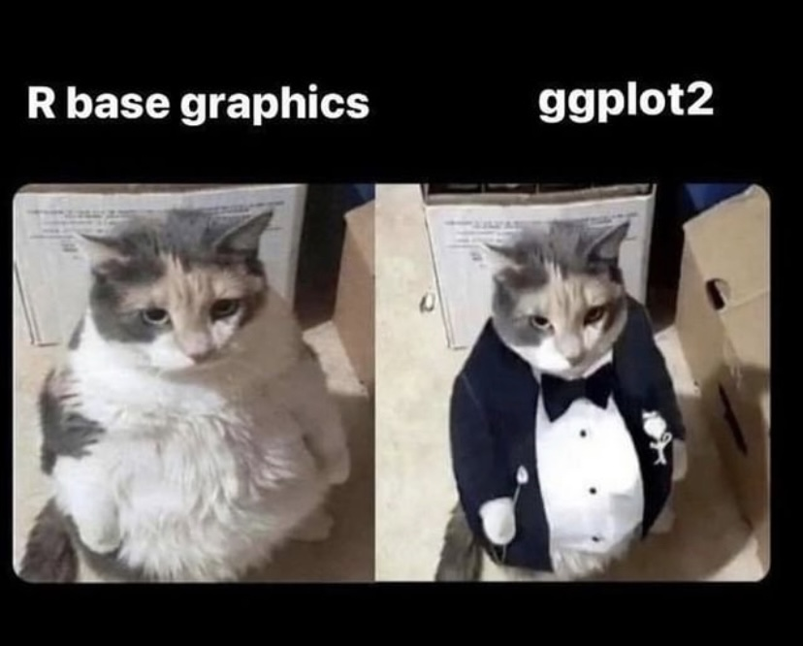
ggplot?
R built-in functions for plots
ggplot

